Slide 1
Prime
SBA Charge Off Prediction

Slide 2
SBA 7(a)
Modeling
Looking Forward
Agenda

Slide 3

SBA 7(a) Program
Eligibility
640 minimum credit score
Operate for profit
Unable to obtain reasonable terms for credit from non-government sources
Structure
$5M maximum
SBA guarantees up to 85% of loans < $150k, 75% of loans > $150k
25 year maximum term
Common Usage
Short and long-term working capital
Refinancing current business debt 25 year maximum term
Equipment/supplies/machinery/etc.
Key: Lender manages the loan, not SBA

Slide 4
Data Selection
Time
Approval date on/after January 1, 2017
Type
Non-revolving (line of credit)
Successfully matched to an Enigma “entity_id”
Outcome
Recorded as paid in full (PIF = 0) or charged off (CHGOFF = 1)
Goal: Simulate a Prime product w/ features that would be available at the time of application

Slide 5
SBA 7(a)
Modeling
Looking Forward
Agenda

Slide 6

Confusion Matrix | ROC Curve
PIF loan | TN (PIF predicted, loan was actually PIF) | FN (CHGOFF predicted, loan was actually PIF)
CHGOFF loan | FP (PIF predicted, loan was actually CHGOFF) | TP (CHGOFF predicted, loan was actually CHGOFF)
 | Predicted PIF “Approved” | Predicted CHGOFF “Denied”

Slide 7
Random Forest
Binary Classification
80-20 Train/Test Split, stratified on LoanStatus
100 trees

Slide 8
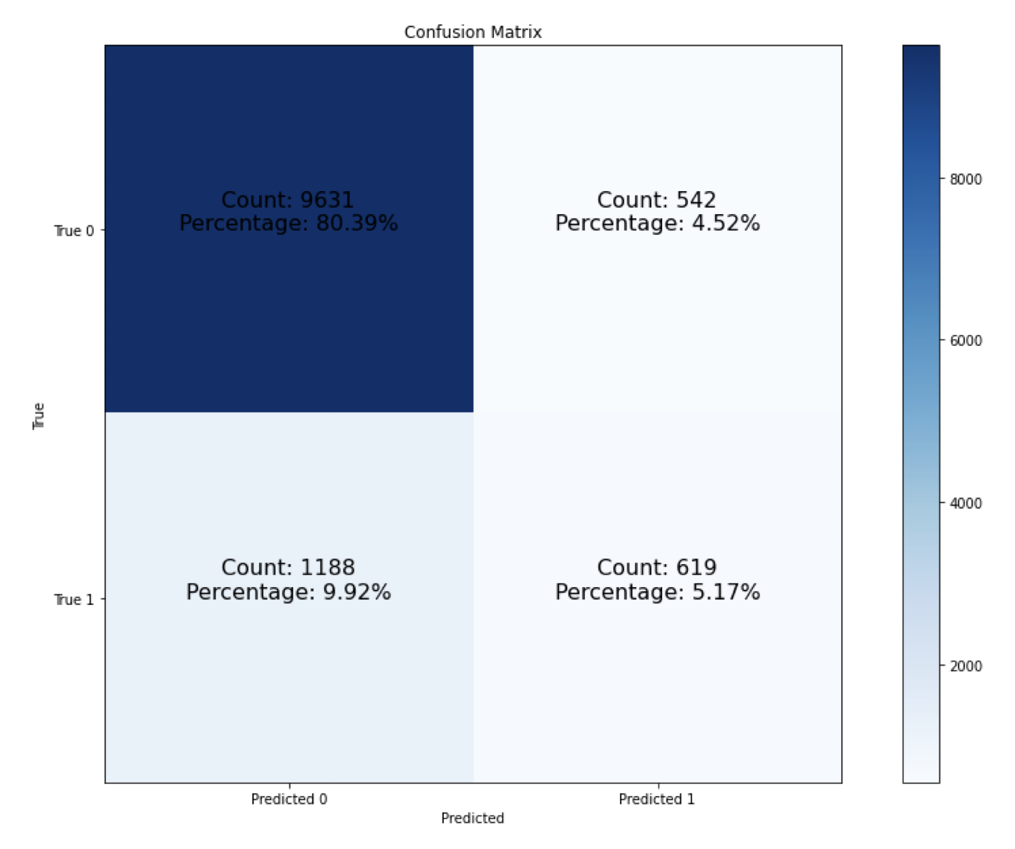
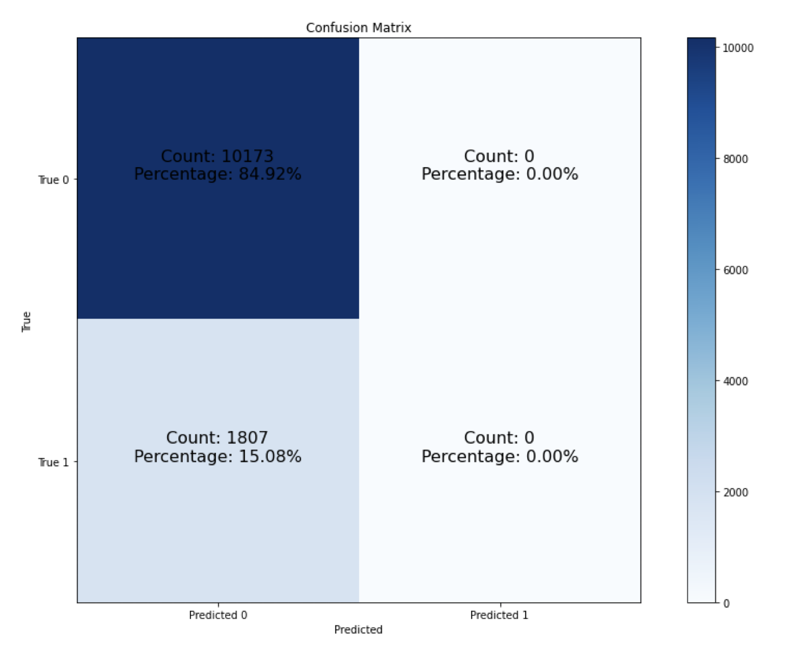
Threshold
None | Threshold = 0.2
ROC AUC: 0.645 Accuracy: 0.856 Recall: 0 | ROC AUC: 0.50 Accuracy: 0.842 Recall: 0.343

Slide 9
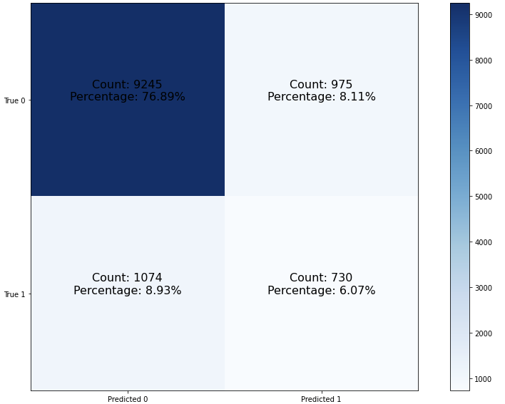
Baseline
Recall | 0.4047 | 0.0
ROC AUC | 0.6546 | 0.0
Accuracy | 0.8296 | 0.0
Count | 11,994 | 0.0

Slide 10
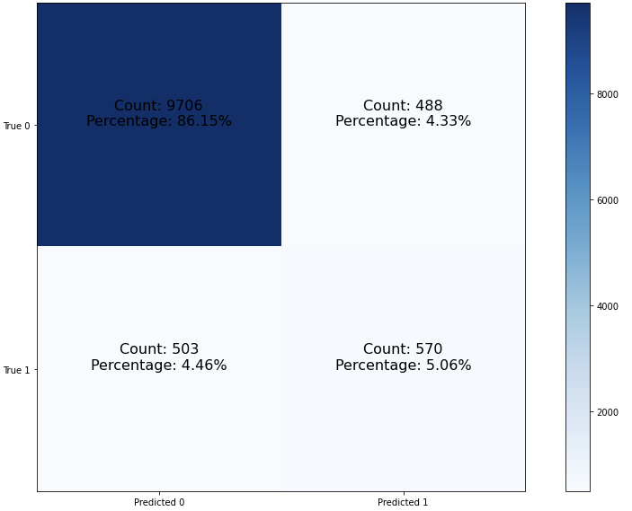
+ Features
Recall | 0.5312 | 0.1265
ROC AUC | 0.7412 | 0.0866
Accuracy | 0.912 | 0.0824
Count | 11,267 | -727

Slide 11
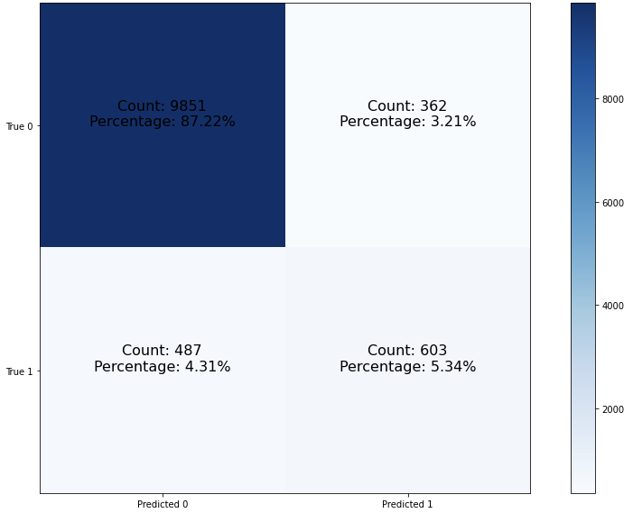
+ Public Data
Recall | 0.5668 | 0.0356
ROC AUC | 0.7651 | 0.0239
Accuracy | 0.9248 | 0.0128
Count | 11,267 | 0

Slide 12
Checking In

Slide 13

+ BEA
Recall | 0.2899 | -0.2769
ROC AUC | 0.6414 | -0.1237
Accuracy | 0.9316 | 0.0068
Count | 7854 | 0

Slide 14
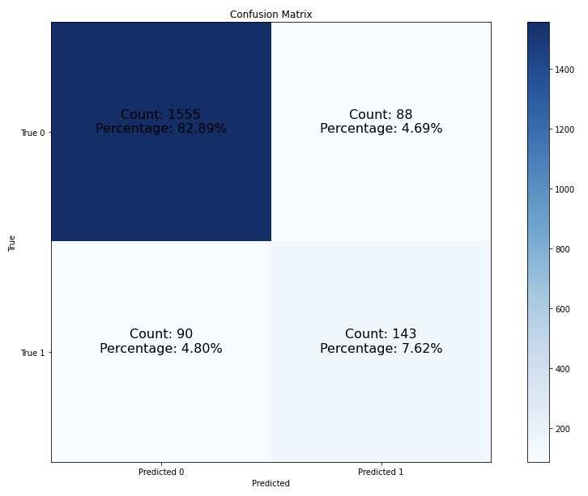
+ Revenue
* change from public data
Recall | 0.6137 | 0.0469
ROC AUC | 0.7801 | 0.015
Accuracy | 0.9051 | -0.0197
Count | 1876 | -9391

Slide 15
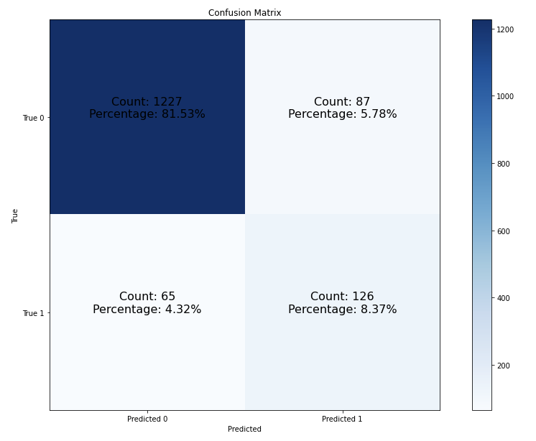
Closing Revenue Gaps
Recall | 0.6597 | 0.046
ROC AUC | 0.7967 | 0.0166
Accuracy | 0.899 | -0.0061
Count | 1505 | -371

Slide 16
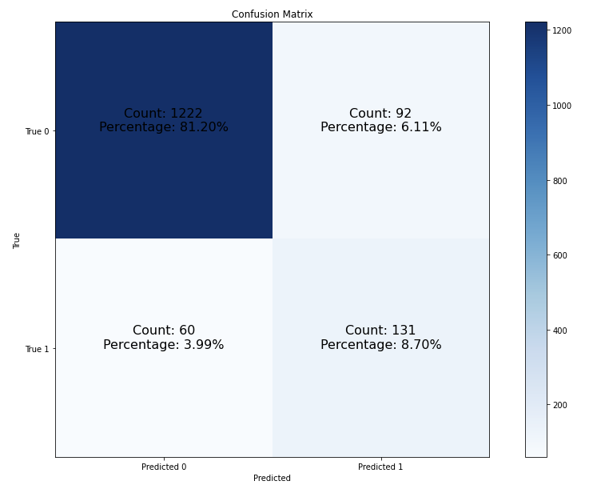
+ Revenue Transformation
Recall | 0.6859 | 0.0262
ROC AUC | 0.8079 | 0.0112
Accuracy | 0.899 | 0
Count | 1505 | 0

Slide 17
Metric Summary

Slide 18
SBA 7(a)
Modeling
Looking Forward
Agenda

Slide 19
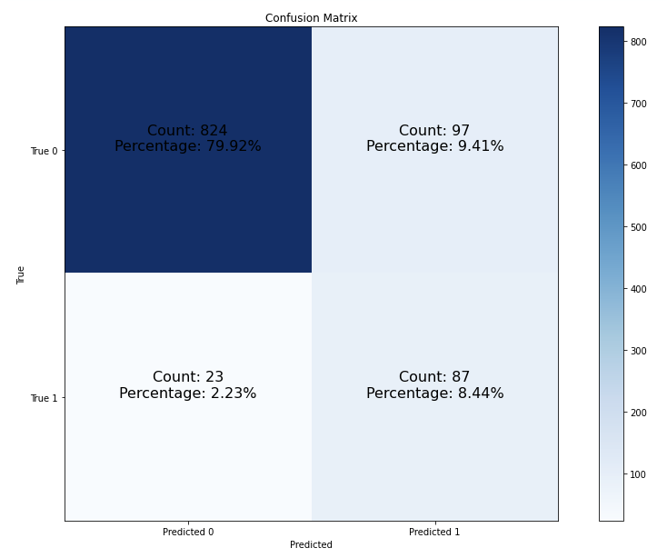
All Features
Recall | 0.7909 | 0.105
ROC AUC | 0.8428 | 0.0349
Accuracy | 0.8836 | -0.0154
Count | 1031 | -474

